Slide 1

Sales Trend Analysis and Customer Insights for Nykaa
By
Joel Benjamin J

Slide 2
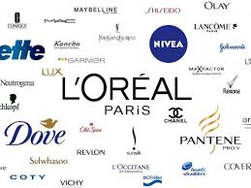
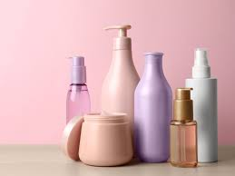
Nykaa Data
Ecommerce Platform.
Multiple Company Products available.
Cosmetic Products.
Sales Data with Customer Review
Customer History with Data is available
Sales Data: 2013 - 2020

Slide 3
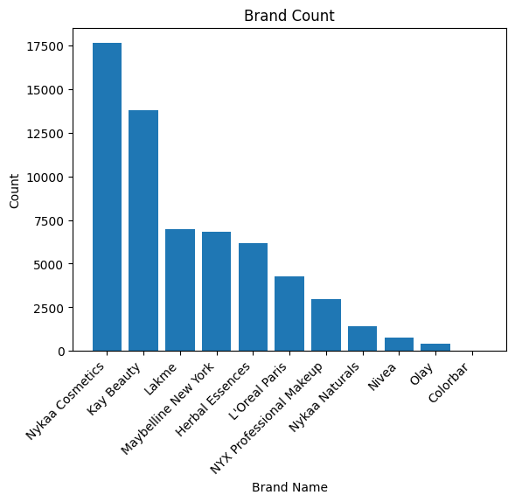
Brand Data
Nykaa Cosmetics – Highest Sales.
Nykaa products: 35% of Overall Record
Nykaa is also a Product based
Kay Beauty – 2nd Place but Top Rating
Nykaa False in the 9th and 10th position in rating
Maybe Nykaa Products has some issues
Each Brand has different products sold.

Slide 4
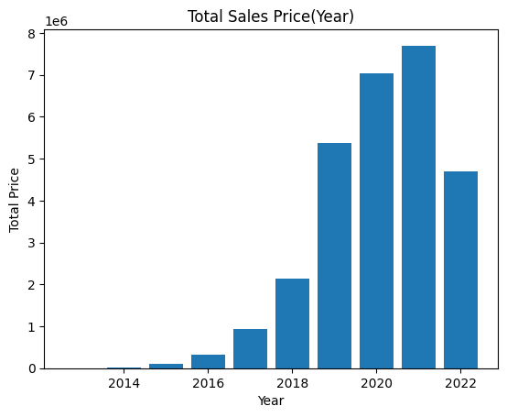
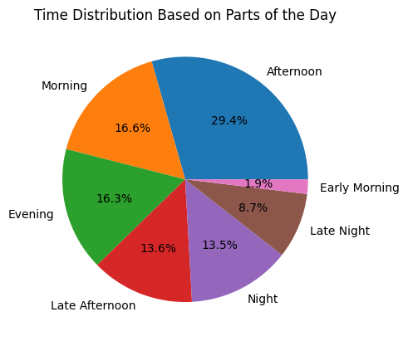
Sales Trend and Patterns
2021: Highest Sold and Revenue Generated
2022 has limited data
Time Period is divided into 7 types.
Afternoon has the highest Distribution

Slide 5
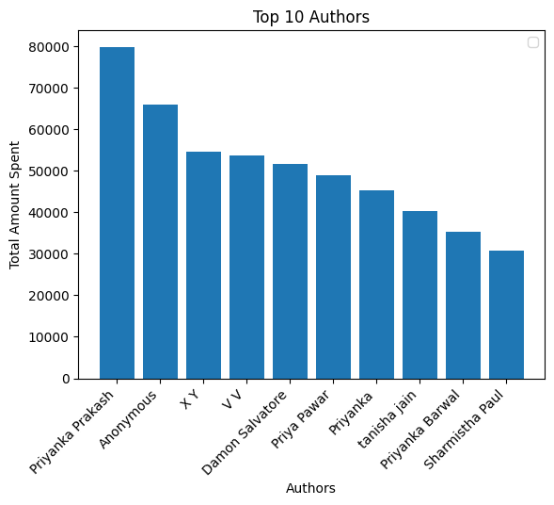
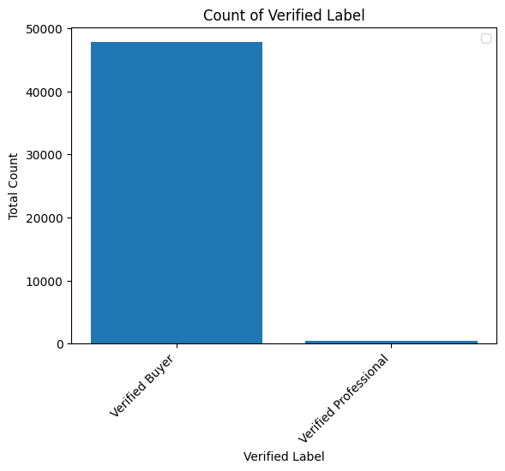
Top Customers
Overall Top 10 Customers.
Top 10 Various based on Brands
Two types of Customer
Some Users are Anonymous
Improper User Names
Challenges to Find them

